Slide 1
Online Quiz Application (Quiz Master)
CAPSTONE PROJECT
Presented By:
Student Name-Jinay Ashok Shah
College Name-Drs. Kiran And Pallavi Patel Global University(KPGU), Vadodara
Department-B.Tech CSE

Slide 2
OUTLINE
Problem Statement (Should not include solution)
System Development Approach (Technology Used)
Algorithm & Deployment (Step by Step Procedure)
Result
Conclusion
Future Scope(Optional)
References

Slide 3
Problem Statement
Traditional methods of practicing quizzes (paper tests, static MCQs) lack interactivity and instant feedback. Existing online quiz platforms are either:
Too complex for small projects.
Require heavy backend and databases.
Not customizable for user preferences (time, difficulty, category).
Hence, there is a need for a lightweight, customizable, web-based quiz system that works directly on the browser and provides instant evaluation using real-time data.

Slide 4
Objectives
The project aims to:
Develop a responsive web quiz platform.
Allow user customization (time limit, question count, difficulty, category).
Integrate Open Trivia DB API for real-time question fetching.
Provide timers, progress bar, and navigation controls.
Display results with score, accuracy, and performance feedback.

Slide 5
System Approach
Frontend Technologies:
HTML5 – Structure of the webpage
CSS3 – Styling and responsive layouts
JavaScript – Dynamic interactivity (cart, filtering, total calculation)
Design Approach:
Modular separation of HTML, CSS, JS.
Clean, responsive layout.
Focus on user experience.

Slide 6
Design Approach
The application was structured into three main screens:
Setup Screen: User selects quiz configuration (time, difficulty, category).
Quiz Screen: Displays question, options, timer, progress bar, navigation.
Results Screen: Shows final score, accuracy, performance message.
👉 This modular design ensures ease of navigation and scalability.

Slide 7
Algorithm (Step 1: Setup & Fetching)
User enters preferences:
Time Limit
Number of Questions
Difficulty
Category
JavaScript builds a custom API request using these inputs.
Questions fetched from Open Trivia DB API.
Each question stored with:
Text, Options, Correct Answer, Category, Difficulty.

Slide 8
Algorithm (Step 2: Quiz Flow)
Timer starts → updates every second.
For each question:
Display text and shuffled options.
User selects → stored in userAnswers[].
Navigation buttons (Prev/Next).
Progress bar updates.
Timer color changes:
Green → Safe.
Yellow → Warning (last 10 mins).
Red → Critical (last 5 mins).

Slide 9
Algorithm (Step 3: Results)
On finishing or timeout:
Stop timer.
Compare userAnswers[] with correct answers.
Calculate: Score, Percentage, Time Taken.
Display results:
Correct answers count.
Percentage score.
Performance message (Excellent, Good, Keep Practicing, etc.).
Provide actions: Restart Quiz / Review Answers.

Slide 10
Key Features Implemented
Customizable Quiz: Time, difficulty, category, question count.
API Integration: Fetches live questions from Open Trivia DB.
Interactive Timer & Progress Bar: Visual tracking.
Navigation Controls: Move between questions.
Performance Messages: Motivation based on score.
Restart Quiz Option: Quick re-attempt.

Slide 11
Deployment
Cross-browser tested (Chrome, Firefox, Edge).
Works on desktop and mobile.
Hosted on GitHub Pages / Netlify for free deployment.
No external dependencies except Open Trivia DB API.

Slide 12
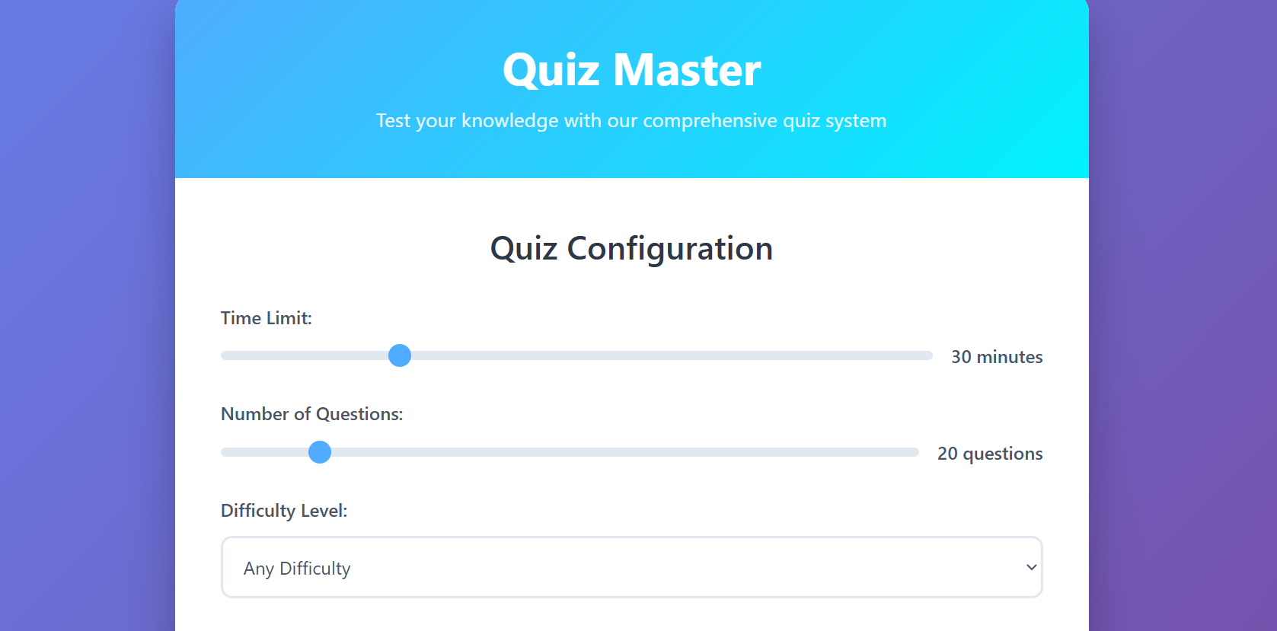
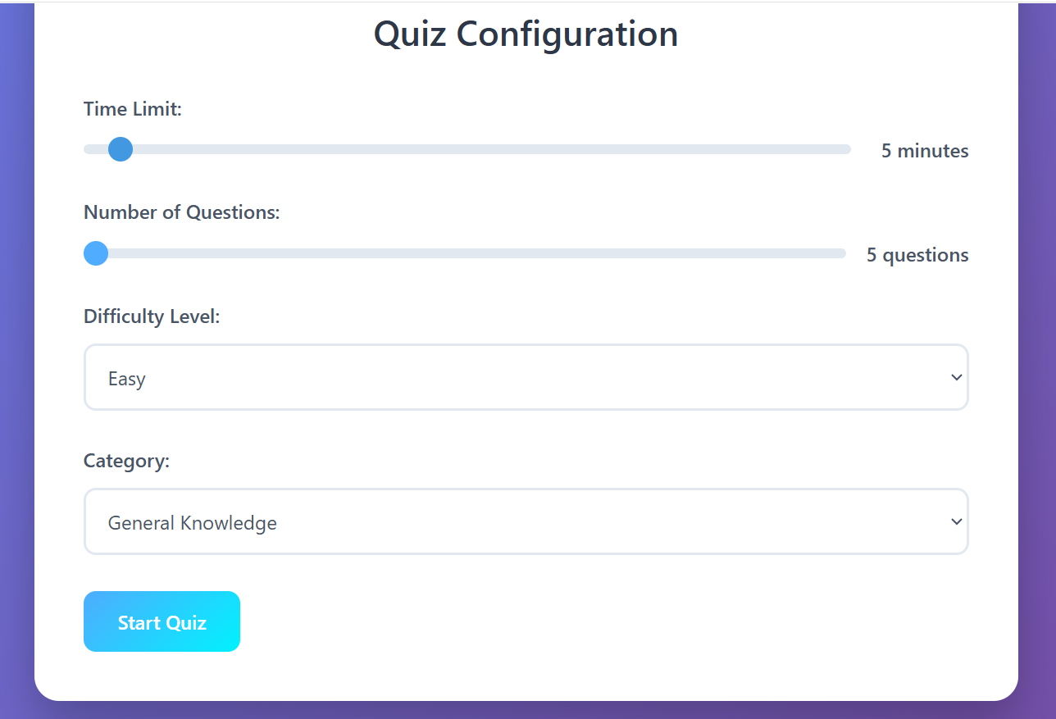
Result
.

Slide 13
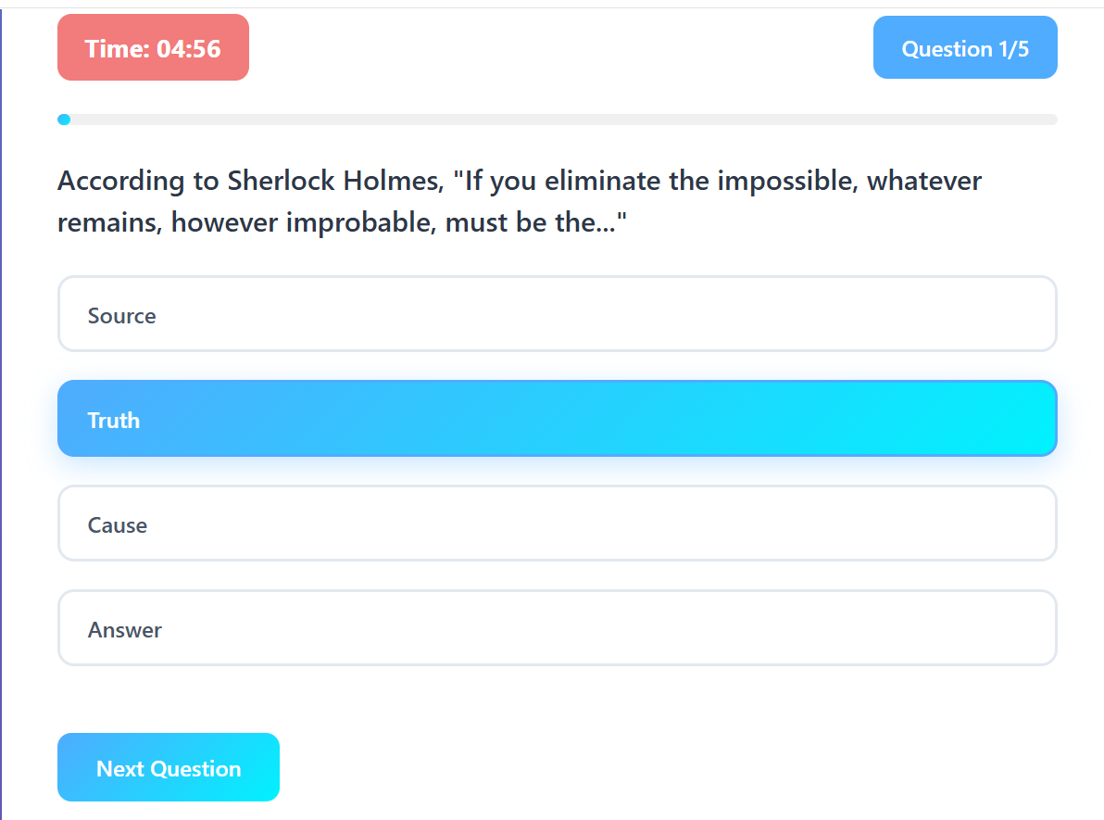
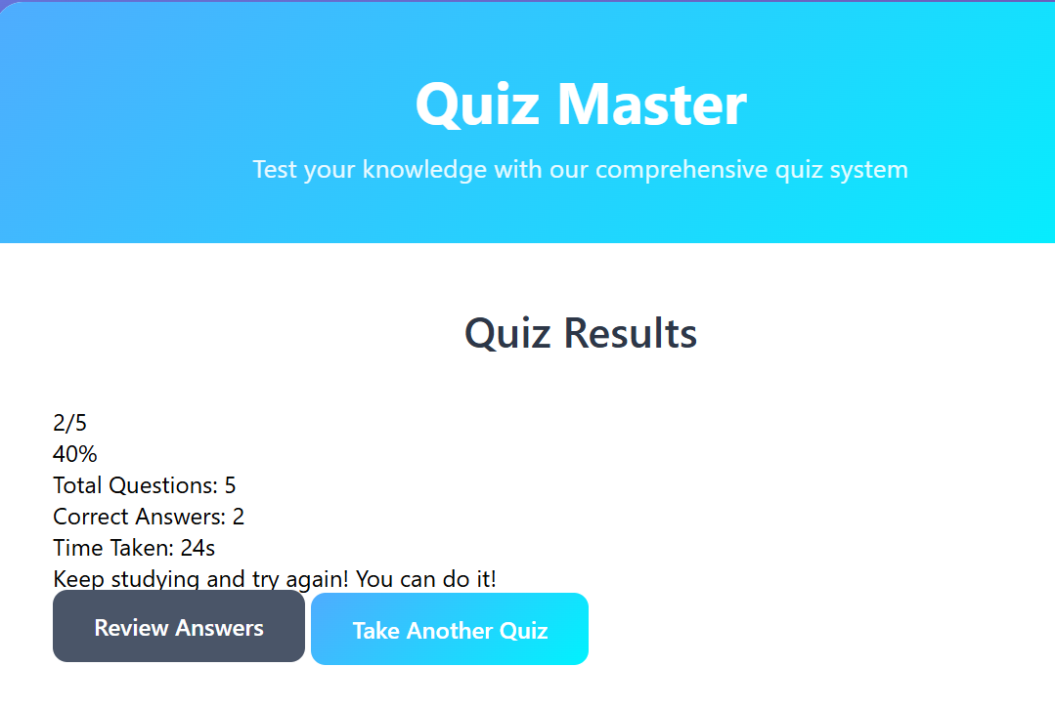
Result

Slide 14
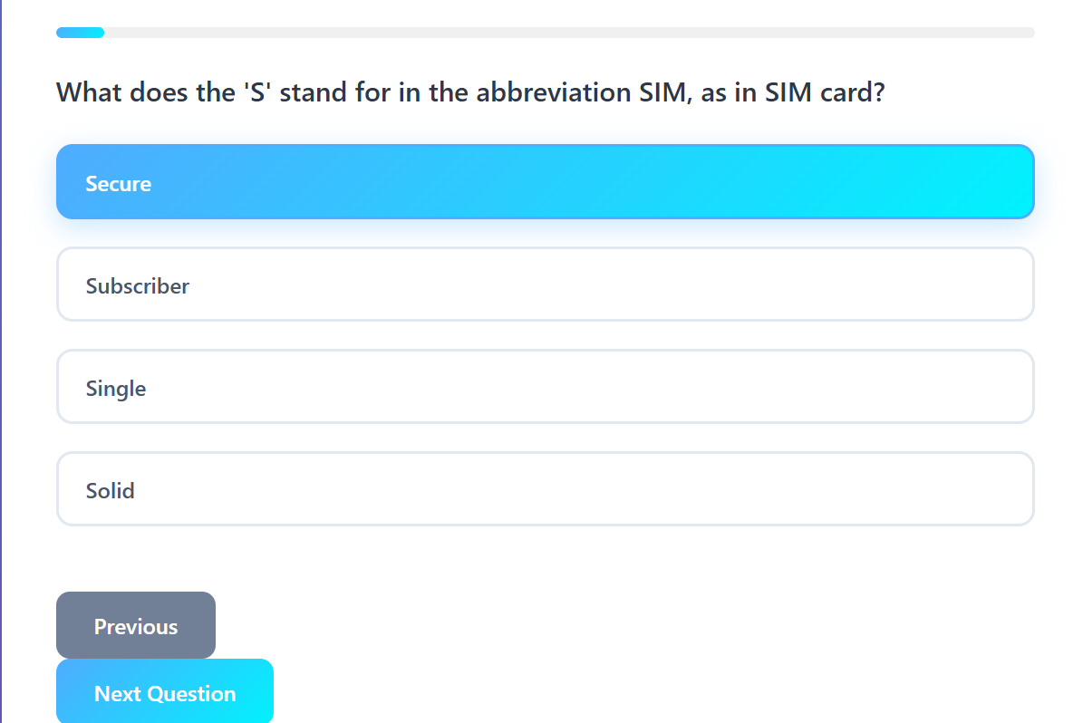
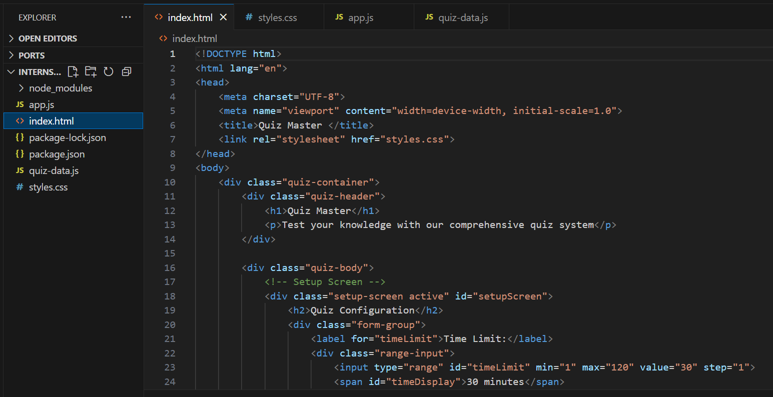
Result
v
Github link:- https://github.com/sjinay21/Online_Quiz_Application_Quiz_Master

Slide 15
Conclusion
Successfully developed a full-featured quiz application.
Provides real-time interactivity and learning experience.
Demonstrates skills in HTML, CSS, JavaScript, API integration.
Lightweight and accessible across devices.

Slide 16
Future scope(Optional)
Add Review Answers (currently alert placeholder).
Integrate Local Storage / Database to save user history.
Add Leaderboards for competitive use.
Use AI for adaptive difficulty questions.
Multi-user quiz sessions for classrooms.

Slide 17
References
MDN Web Docs (DOM, Fetch API): https://developer.mozilla.org
W3Schools JavaScript: https://www.w3schools.com/js
Open Trivia DB API: https://opentdb.com/

Slide 18
THANK YOU

